Slide 1
SENG8051: Midterm project Performance Testing of Musical World Project
Presented by
Pratham Parekh – 8970812
Ankit Soni – 8972159
Jay Sindhal – 8963474
Shruti Patel – 8974438

Slide 2
Setting Up "Musical World" with Vagrant: A Project Overview
Project Overview:
Our project is the "Musical World" PHP application.
It involves configuring web and database servers to host the app.
Initial Setup:
We will use Vagrant to set up two virtual machines for the web and database servers.
This ensures a consistent development environment.
Using Vagrant:
Vagrant creates and manages virtual development environments.
We will create two virtual machines: DB-Server and Web-Server.

Slide 3
Installation of Musical World Project
Clone the project from GitHub:
git clone https://github.com/thealoneprogrammer/Musical-World
Configure the web server using Vagrant.
Set up the database.
Connect the web server to the database server.

Slide 4
Deploying the Project with Vagrant
Initially, we used Vagrant to start our virtual machines:
Web Server
Database Server
Our project is deployed and running at http://192.168.56.10/project/

Slide 5

Project Screenshots
Index page

Slide 6
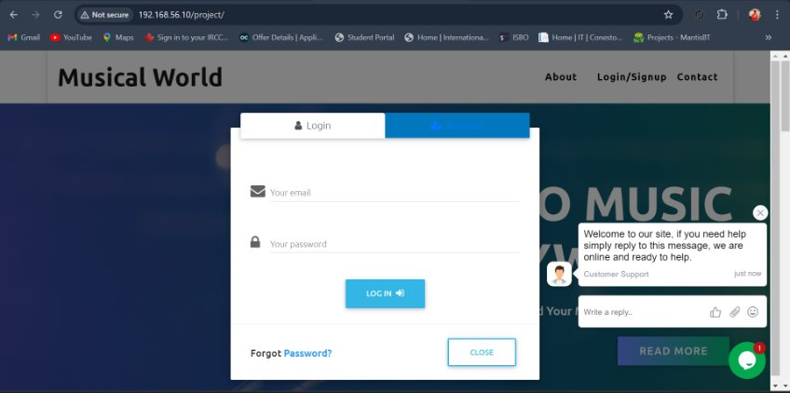
Project Screenshots
Login/Register

Slide 7
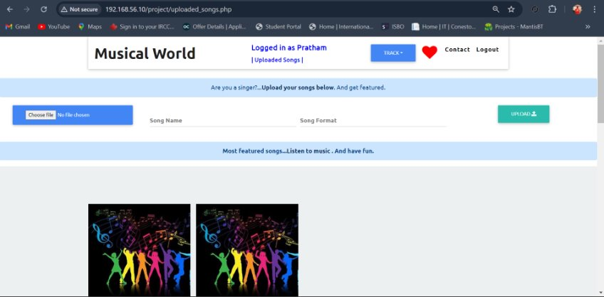
Project Screenshots
Song upload page

Slide 8

Performance Testing Overview
Performance testing involves validating the stability and response time of a website by applying load and assessing its performance.
We conducted performance testing using two primary approaches:
Python Scripts:
This approach details the process of load, stress, and reliability testing using Python scripts.
JMeter:
This method evaluates the system's capacity and volume handling capabilities using JMeter, a robust performance testing tool.

Slide 9
Load Test
User Count: 100 - 200: The response time starts at 35.01 ms and increases sharply to 120.25 ms.
User Count: 300: The response time jumps significantly to 400.62 ms.
User Count: 400: The response time peaks at 500.77 ms.
User Count: 500 - 600: The response time decreases to around 450.14 ms and 430.18 ms.
User Count: 700 - 1000: The response time remains relatively stable around 460 ms to 415 ms.
The optimum path is where the system can handle the maximum number of users with an acceptable response time before it degrades sharply.
The optimum path is likely around 300 users with an average response time of 400.62 ms.
This point balances the maximum number of users with an acceptable response time before the system's performance starts to degrade significantly.

Slide 10
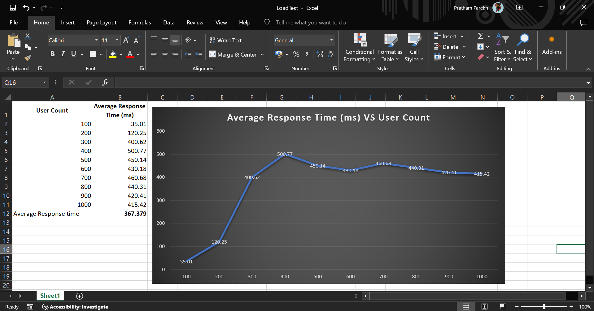
Load Test

Slide 11
Stress Test
During stress testing, we determined how many users the website can handle before crashing.
We tested various user loads to find the limit.
We found that the website can manage up to 1500 users.
When the number of users exceeds 2000, the website encounters errors, and Timeout.

Slide 12
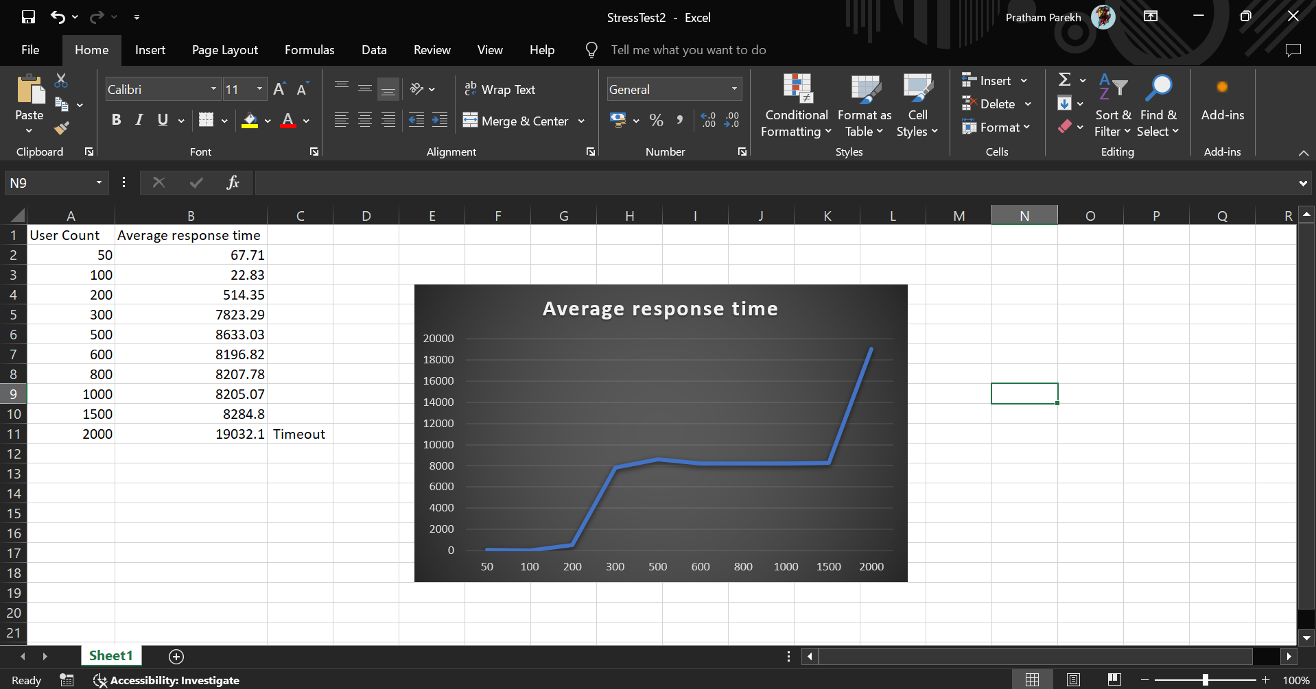
Stress Test

Slide 13
Reliability Test
Reliability testing checks if the application stays stable and performs well under a constant load over time.
We tested the system's consistency by applying a steady user load using Python scripts for several hours.
We measured uptime, error rate, and response time stability.
Total hours: 2hr/ 120minutes.

Slide 14
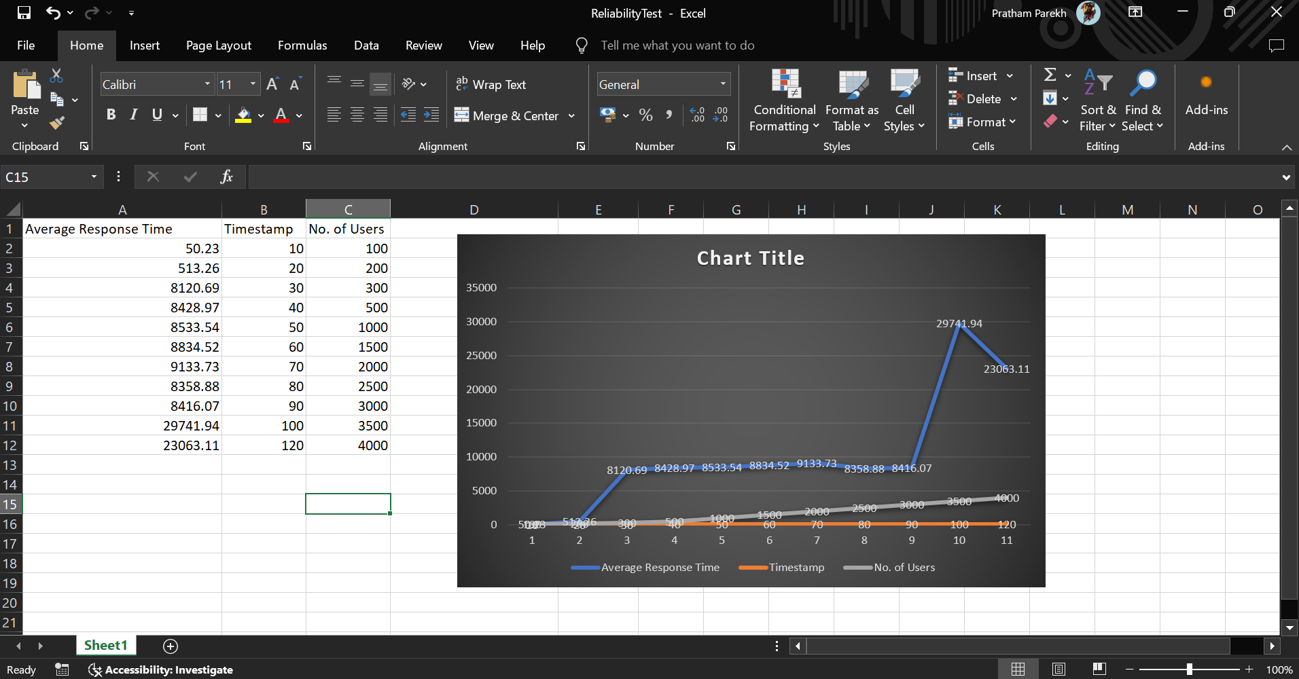
Reliability Test

Slide 15
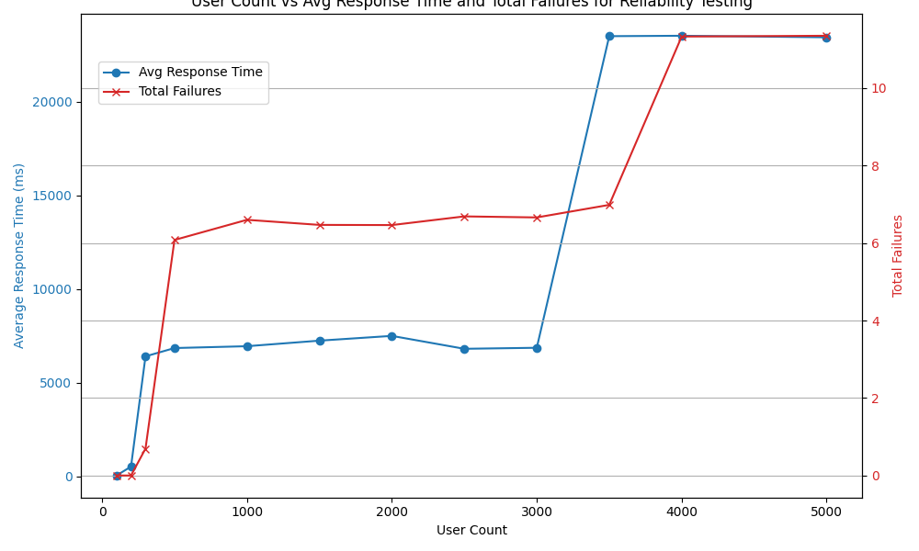
Reliability Test

Slide 16
Capacity Test
Capacity testing evaluates how well the system handles loads beyond its normal operating levels.
Also known as endurance testing, it assesses the system’s ability to sustain performance over time.
We ran this test for 6 hours with varying user loads.
We generated a graph showing the timestamp and average response time from the data.

Slide 17
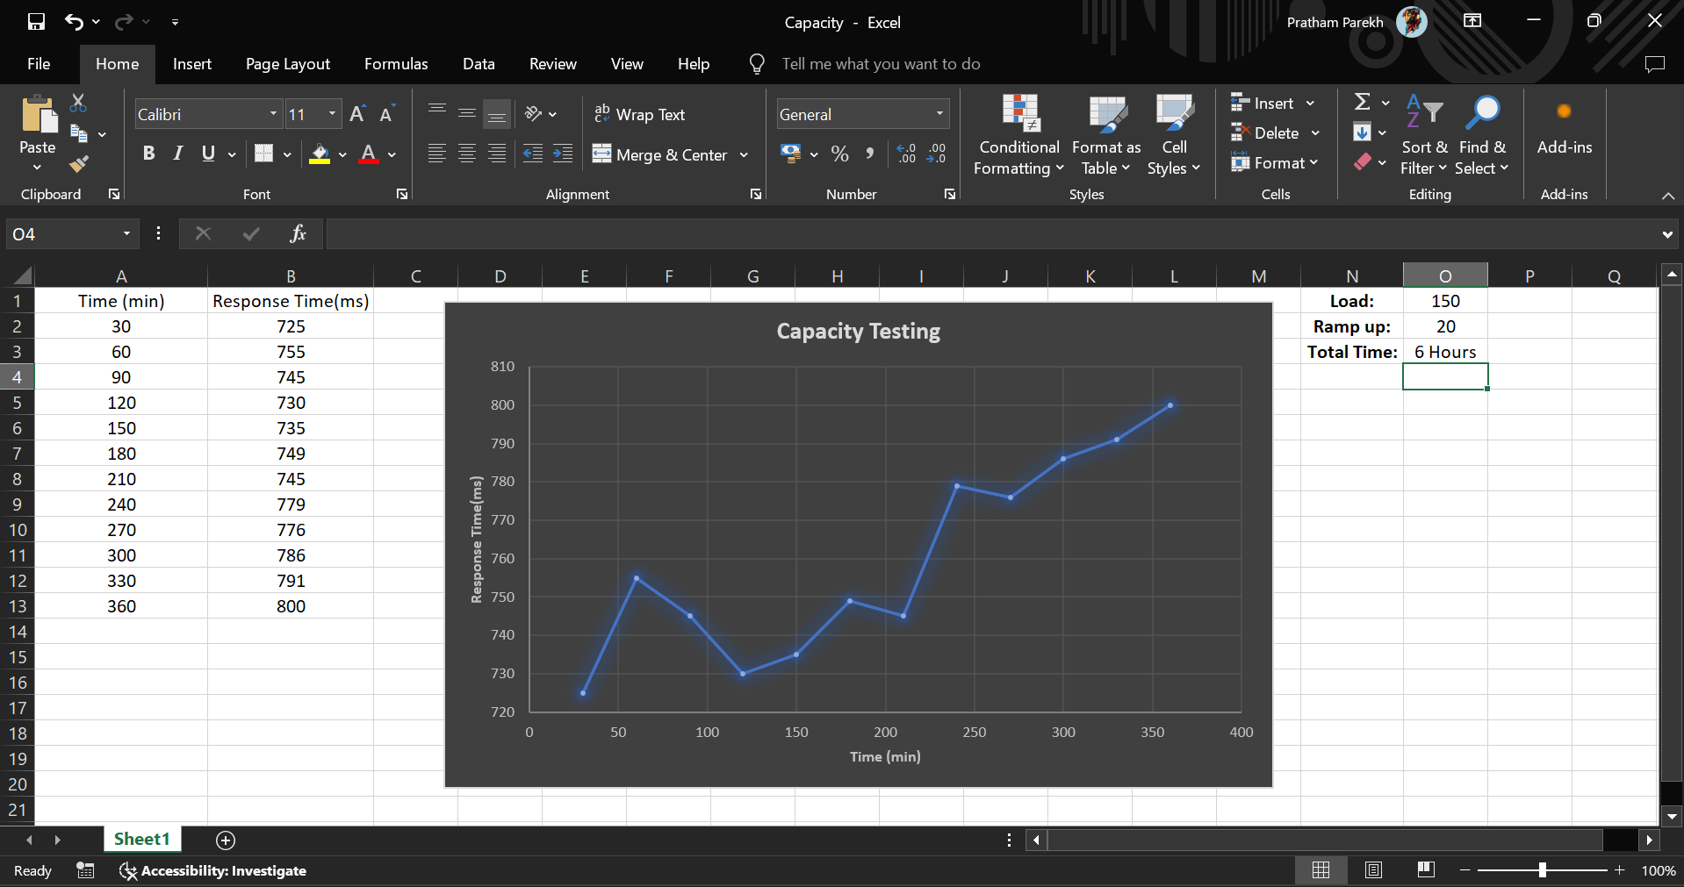
Capacity Test

Slide 18
Volume Test
Volume testing, also known as flood testing, examines the system's database capacity by flooding it with a high volume of data.
We analyze the dataset to identify performance degradation, scalability issues, and database limitations, which are crucial for optimizing performance and maintaining stability at scale.
We created a graph showing volume and average response time from the data.

Slide 19
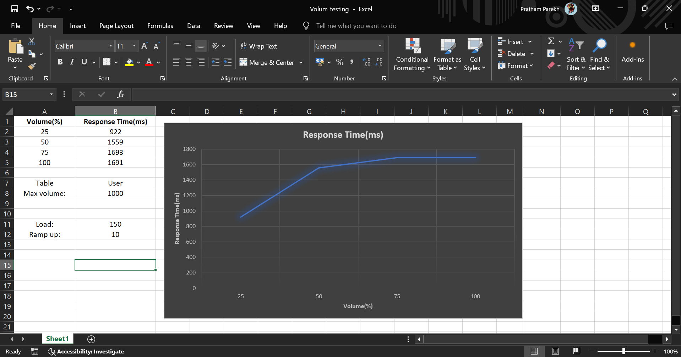
Volume Test

Slide 20
Future Enhancements
Scalability Testing Implementation:
Objective: Assess how well the application can handle increasing load and resource demands.
Method: Implement scalability testing to evaluate performance under different scaling scenarios.
Difficulties Faced:
Test Environment Configuration: Challenges in setting up and configuring test environments caused delays.
Time Constraints: Limited time available for thorough testing and analysis.

Slide 21

Thank you

